Slide 2
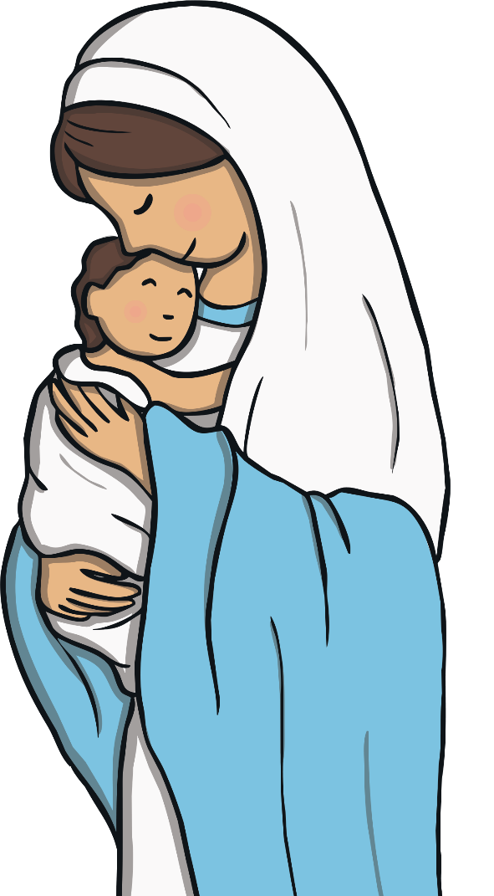
Christmas Origins
Italy is a very religious country.
The Pope, the leader of the Catholic Church, lives in Rome.
The word “Natale” means “day of the birth” which helps the people remember the importance of the birth of Baby Jesus.
At midnight on Christmas Eve, in every Italian Catholic Church, a special Christmas mass is held.

Slide 3
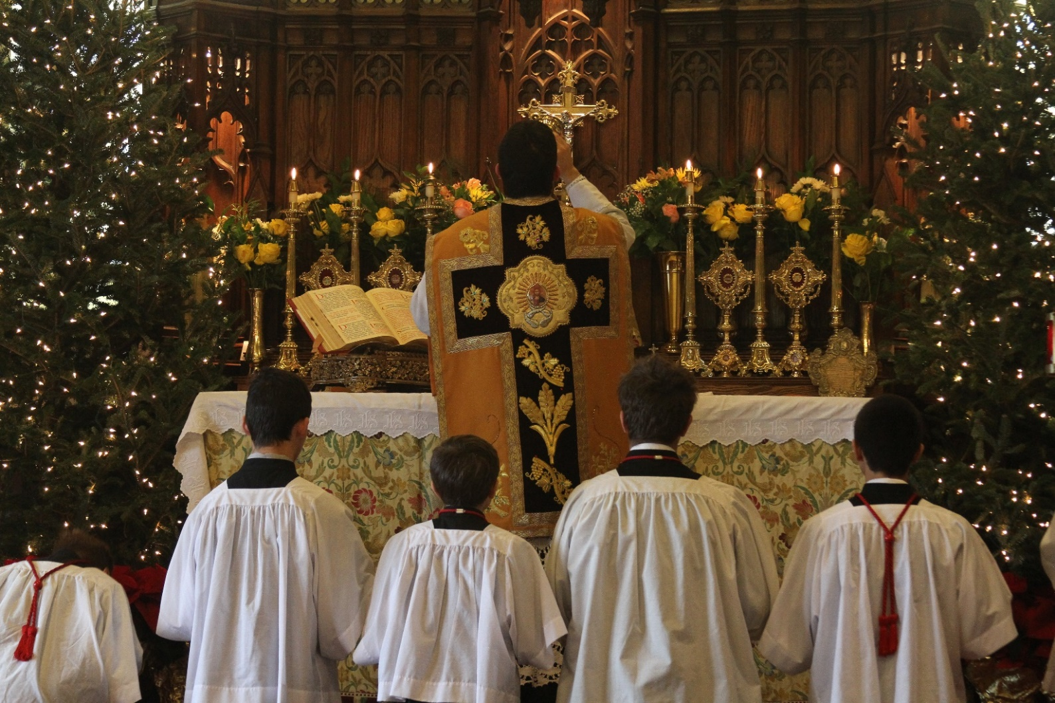
Christmas Mass
Photo courtesy of (jcapaldi@flickr.com) - granted under creative commons licence

Slide 4
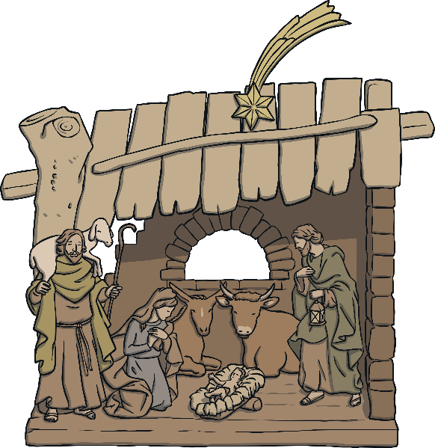
Christmas Traditions: The Nativity Scene
In Italy, most families prepare a Christmas Tree and a Nativity scene in their houses. Sometimes families pass down the figures of the Nativity scene from generation to generation. Some can be centuries old!
The nativity scene is so popular that every year million of little figures are sold. Some scenes can include small fountains, fairy lights, real grass and even sound effects!
It is also very popular for people to re-enact the Nativity in Live Nativity scene performances, normally in Church.

Slide 5
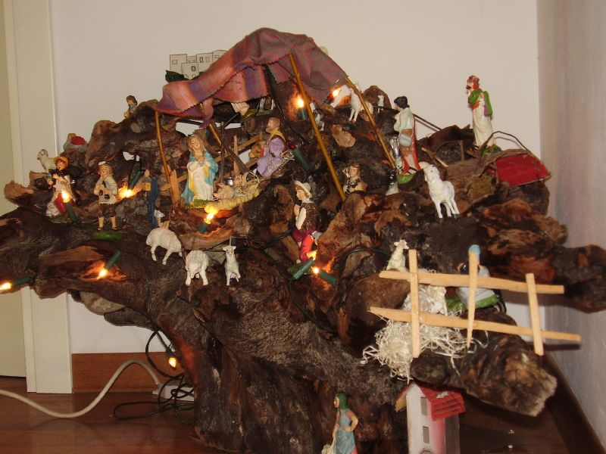
Nativity Scene
Photo courtesy of (acerasa@flickr.com) - granted under creative commons licence

Slide 6
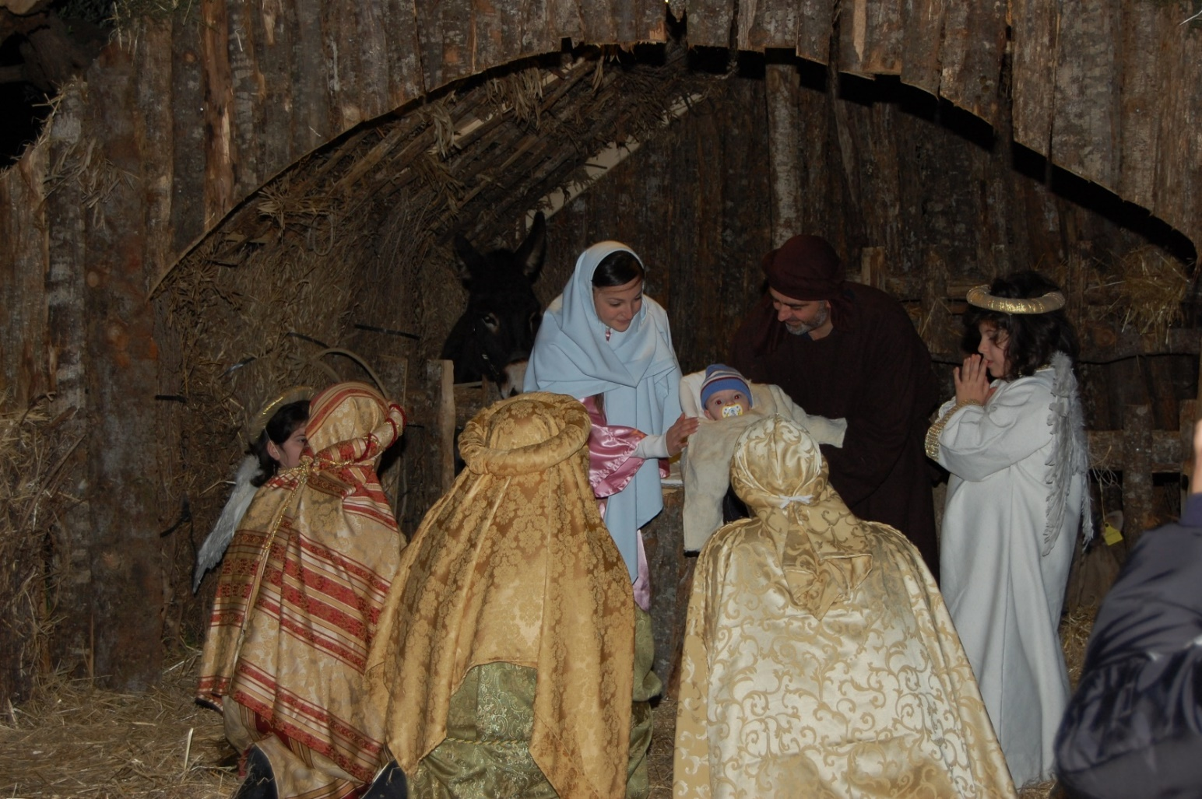
Live Nativity Scene
Photo courtesy of (dontommaso@flickr.com) - granted under creative commons licence

Slide 7

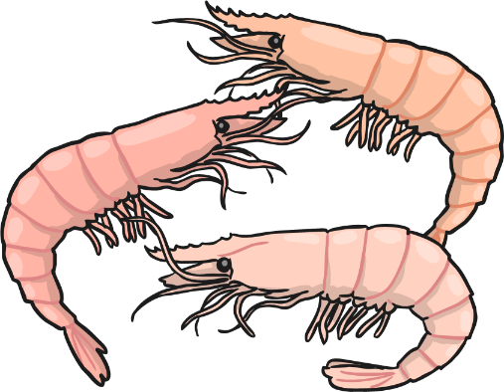
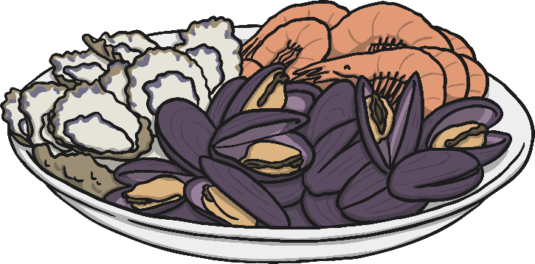
Christmas Meal
In Italy, the traditional Christmas meal includes fish and seafood.
This is because, according to the Catholic tradition, Christmas is a time of remembrance and penitence.
This means that food that was considered a luxury (like meat) is to be avoided. This is to show respect and devotion for the birth of Jesus.

Slide 8
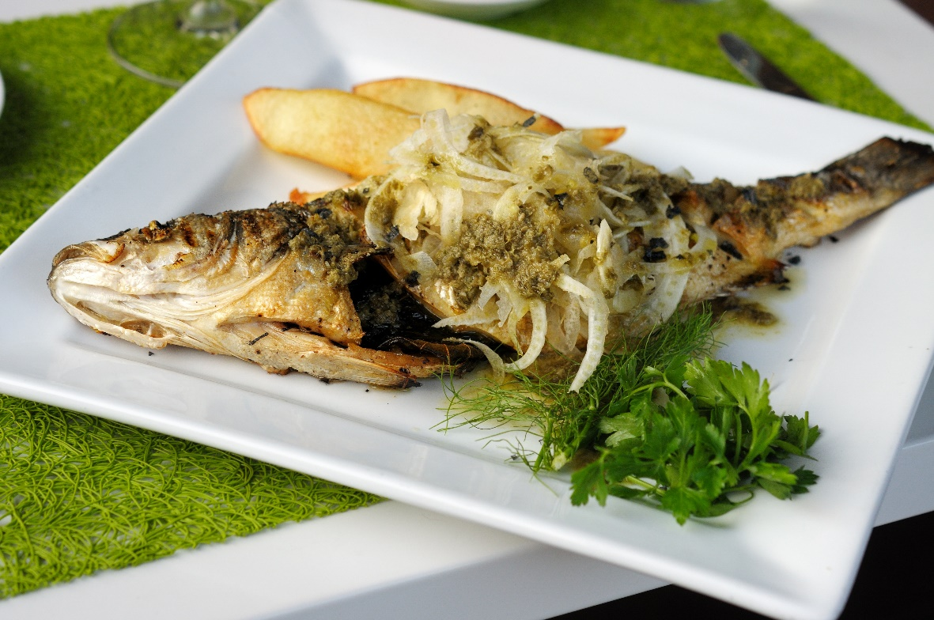
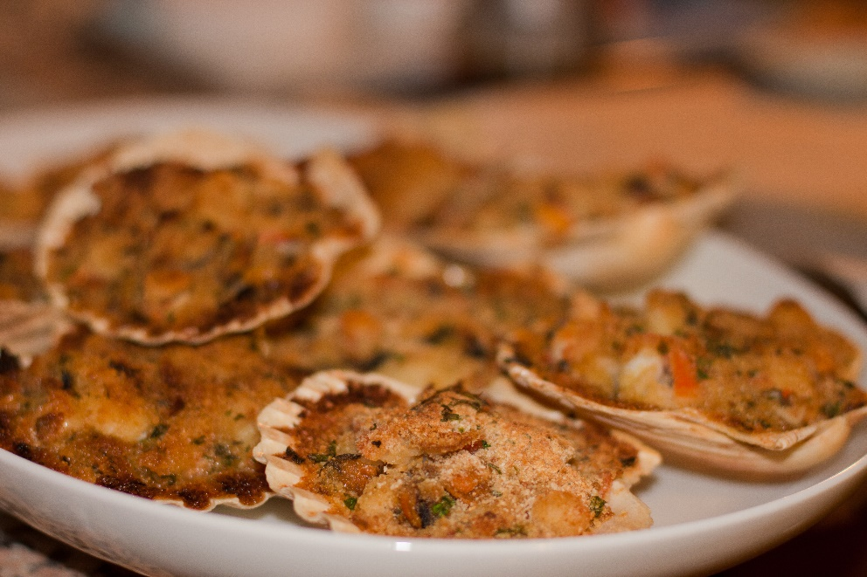
Christmas meal
Photo courtesy of (ralphandjenny@flickr.com) (matte4president@flickr.com) - granted under creative commons licence

Slide 9
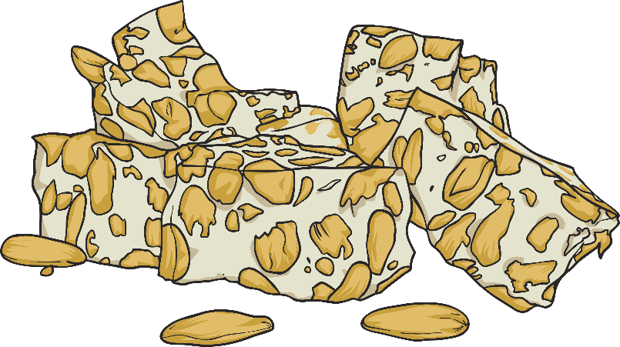
Christmas Puddings
Traditional Italian Christmas puddings are of different regional origins.
They are all very popular in Italy and in the rest of the world.
The most famous are the pandoro (a type of brioche),
panettone (a sweet bread full of nuts and dried fruit)
and torrone (nougat).

Slide 10
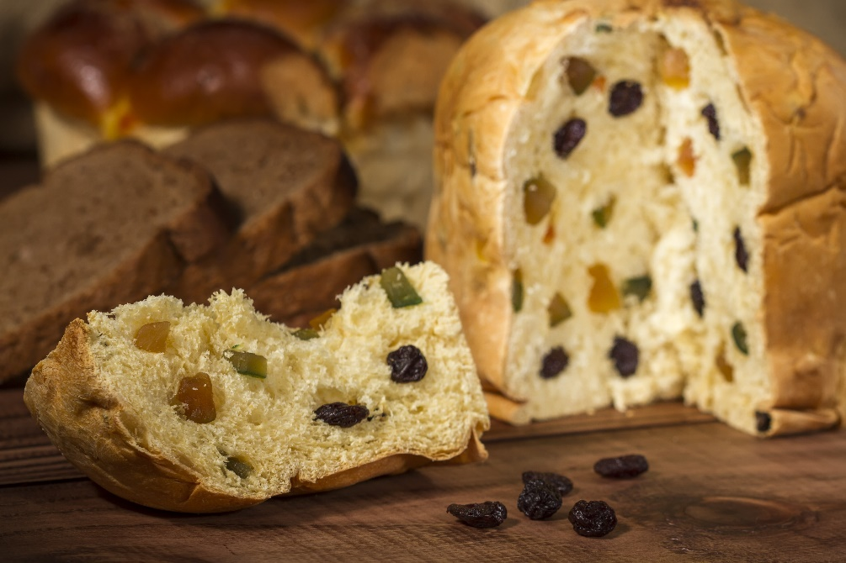
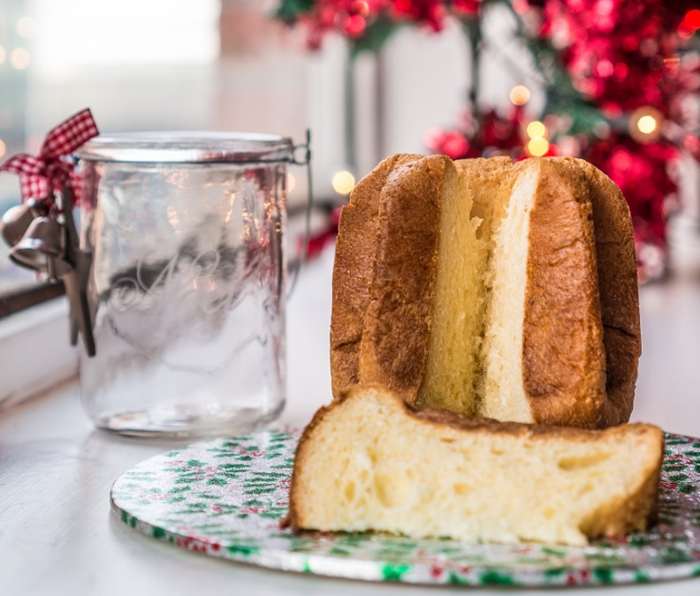
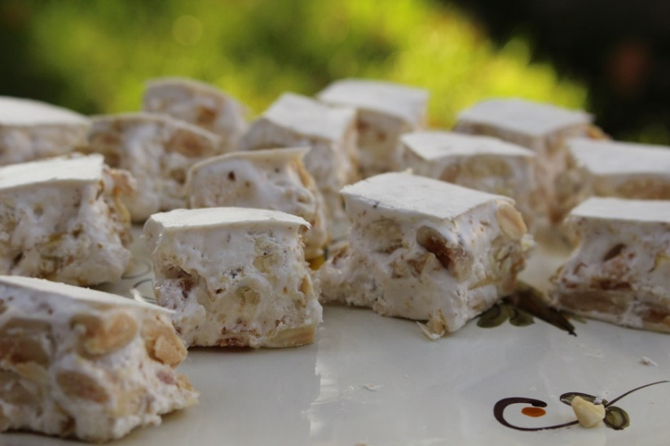
Christmas puddings
Panettone
Pandoro
Torrone
Photo courtesy of (giuseppemilo@flickr.com) (visittuscany@flickr.com) - granted under creative commons licence

Slide 11
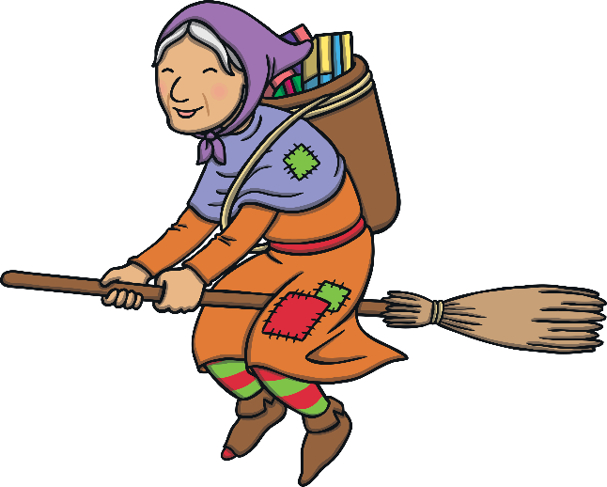
La Befana
La Befana is a little old lady dressed in old, worn out clothes who flies to the houses of Italian children on the 6th of January. She will fill the Christmas stockings with small toys, sweets and fruit. If the children didn’t behave nicely during the year, she will fill the stocking only with coal.
La Befana comes between the night of the 5th and the 6th of January as an auspicious symbol of happiness and presents. Just as the three kings brought gifts to baby Jesus on the same night.

Slide 12
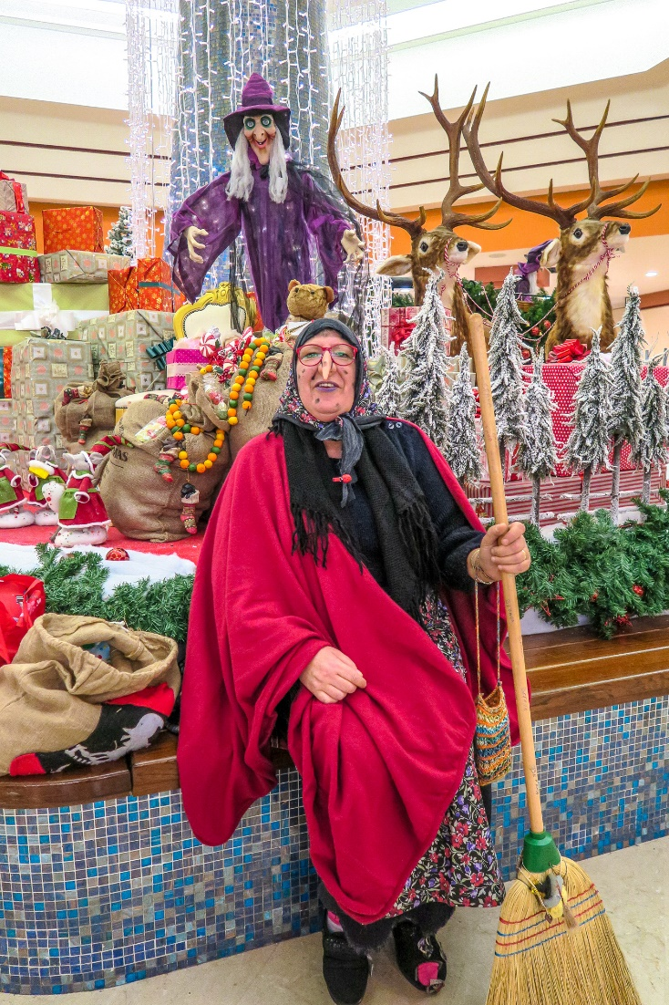
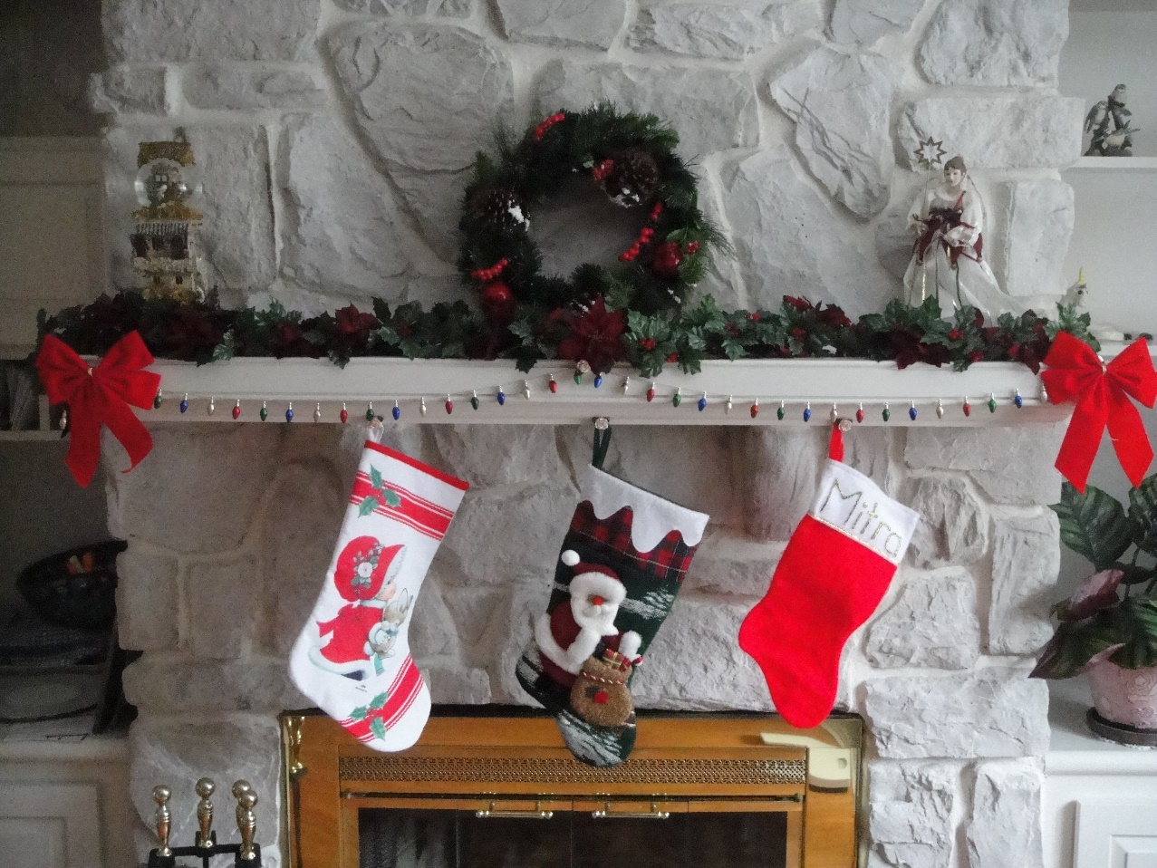
La Befana
Photo courtesy of (marantoni1950@flickr.com) - granted under creative commons licence

